Slide 1


School of Computing Engineering
Testing and refactoring
Programming Methodology
1
Notes:
1

Slide 2
Debugging
Finding and fixing bugs (defects) in programs
Debugger Program that can run your program line by line showing you exactly how the computer sees your code at any moment during execution
  Think of the debugger as the VAR in football, allowing you to see step by step what happened in a given play.
  The debugger should be considered your best friend while programming.
  Using the debugger to find errors can greatly reduce the time it takes to fix errors in a program.
2
Notes:
2

Slide 3
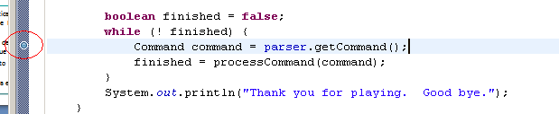
Breakpoint
Breakpoints can be set by clicking in the right side of the file being edited
Breakpoints can be customized indicating
  The number of “hits” (times the execution flow has reached that point)
  A conditional expression
3
Notes:
3

Slide 4

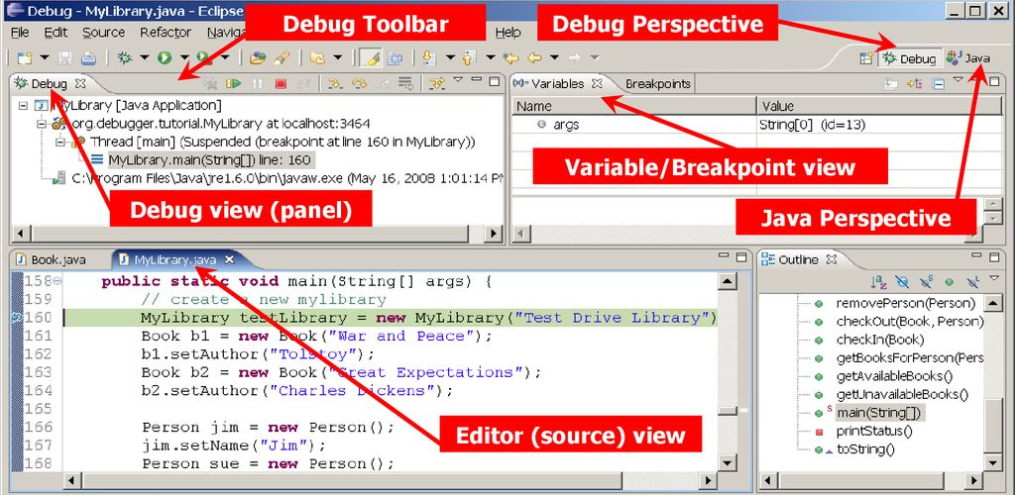
Debug perspective
Last breakpoint
Current line of code (highlighted)
4
Notes:
4

Slide 5
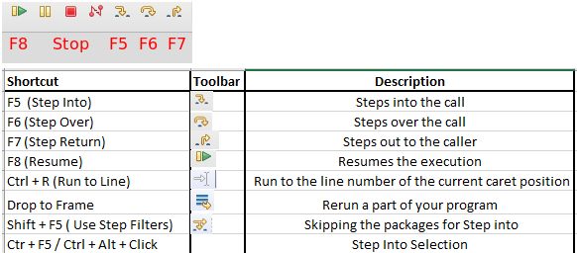
Common debugging commands
5
Notes:
5

Slide 6
Refactoring
Code refactoring is a disciplined technique for restructuring an existing body of code, altering its internal structure without changing its external behaviour
Its purpose is to improve some of the non-functional attributes of the software
  Maintainability, readability, runtime performance…
There are lots of refactoring techniques
Many are supported by the Eclipse IDE
  See the Refactor menu
We will learn them when we require their use
6

Slide 7
Rename
Let’s revisit our game project
In case we want to rename the class to Game2048 we should
  Rename the name of the class
  Rename the constructor
  Change the type of every Game2048 variable (even in other files such as GameApp.java)
  Change the invocation to every constructor (even in other files such as GameApp.java)
It might seem a simple task, but it is error-prone and commonly involves an important waste of time
7

Slide 8
Rename
Renaming a type or variable is very simple
  Menu: Refactor | Rename
  Shortcut: Alt + Shift + R
The Eclipse IDE performs the five steps for you
Let’s change the name of our project from lab01 to lab02 !
Let’s change the package lab01 to lab02 !
8

Slide 9
TO DO
9

Slide 10
To do
Rename the project
surname1_surname2_name_lab02_game
Complete it
Review your project and complete the checklist.
  Fill it and copy it inside the root of your project, before exporting
10
Notes:
10

